Slide 1

Telecom Customer Churn Prediction
Presented by Nour Kamaly

Slide 2

Feature importance
Smart Product
Voice Recognition
Artificial Intelligence
VR

Slide 3
Experiments

Slide 4
Uses of Virtual Reality

Slide 5
Preprocessing Pipeline

Slide 6
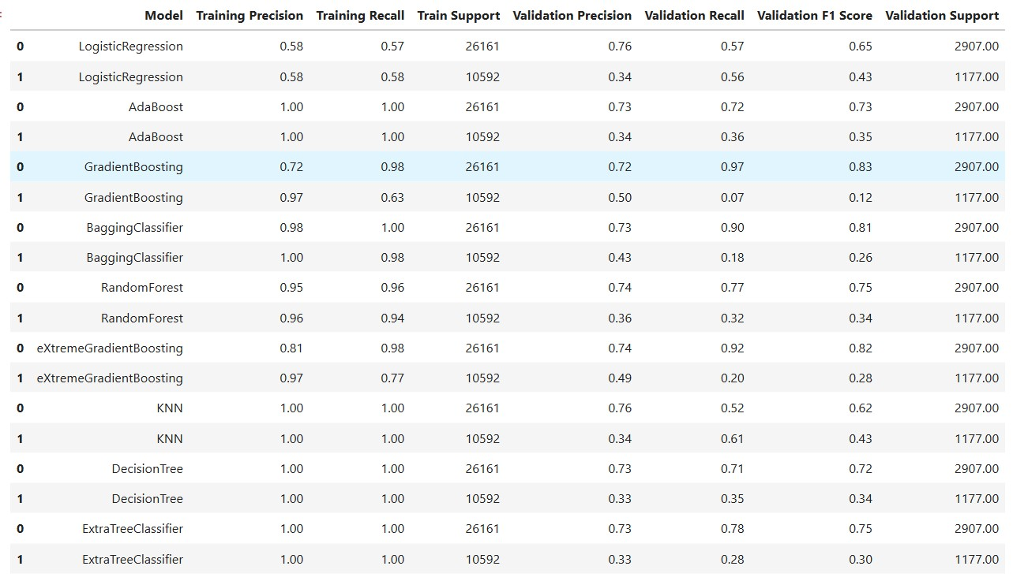
Experiments - SMOTE

Slide 7
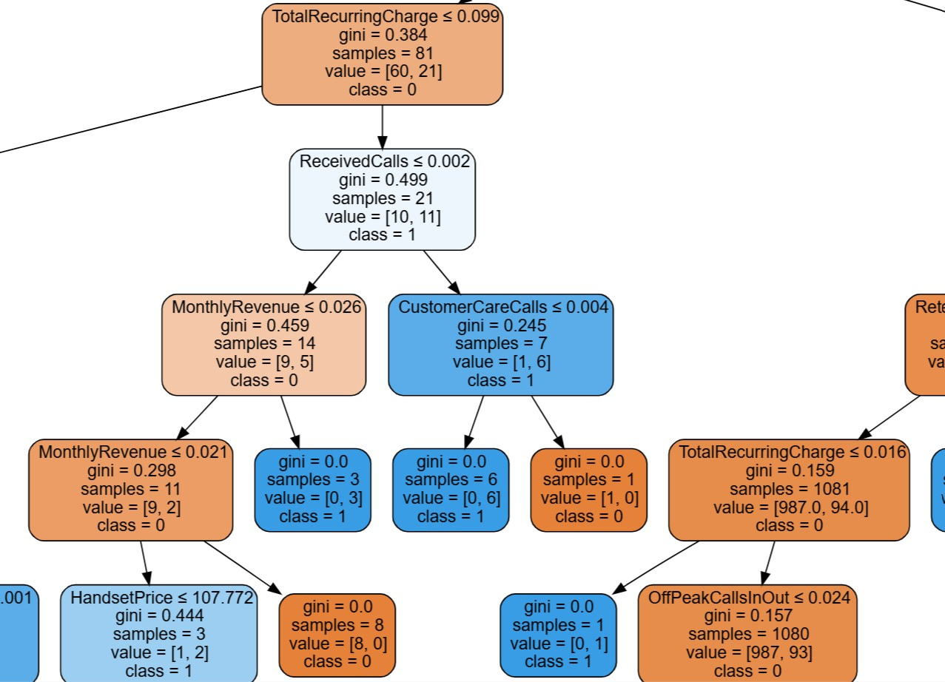
Experiments
Orange -> no class
Blue -> yes class
More saturated shade -> more purity

Slide 8
Experiments – Random Over Sampling

Slide 9
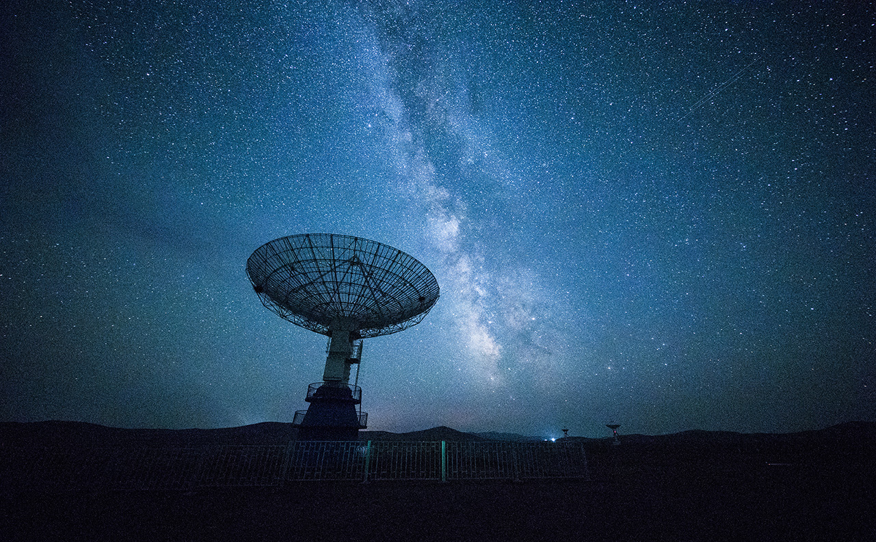
Network Technology
Problem Solving
Algorithm
Automation

Slide 10

Thank You!
nourkamaly26@gmail.com

